Slide 1
CASHIER APP PROJECT
AST / ACICT
Team Members:
Eslam Saeed Abd Elaty
Hossam Hazem Saeed
Ahmed Abd Elkareem Fawzy
Reem Mahmoud Mohamed
Under the supervision of: Mahmoud Abd El Aziz

Slide 2
Project Description
The Cashier App is an innovative platform
designed to streamline the payment process
and sales management for stores and
restaurants. This app enables business
owners to track sales and manage inventory
effectively, enhancing customer experience
and increasing operational efficiency.

Slide 3
Key Features
User-friendly interface.
Multiple payment options (credit cards, e-wallets, cash).
Detailed reports on sales and inventory.
The possibility of returning or replacing a product in the invoice.
Make pdf reports for all data in the application.
The possibility of performing some of the most important operations online and offline.

Slide 4
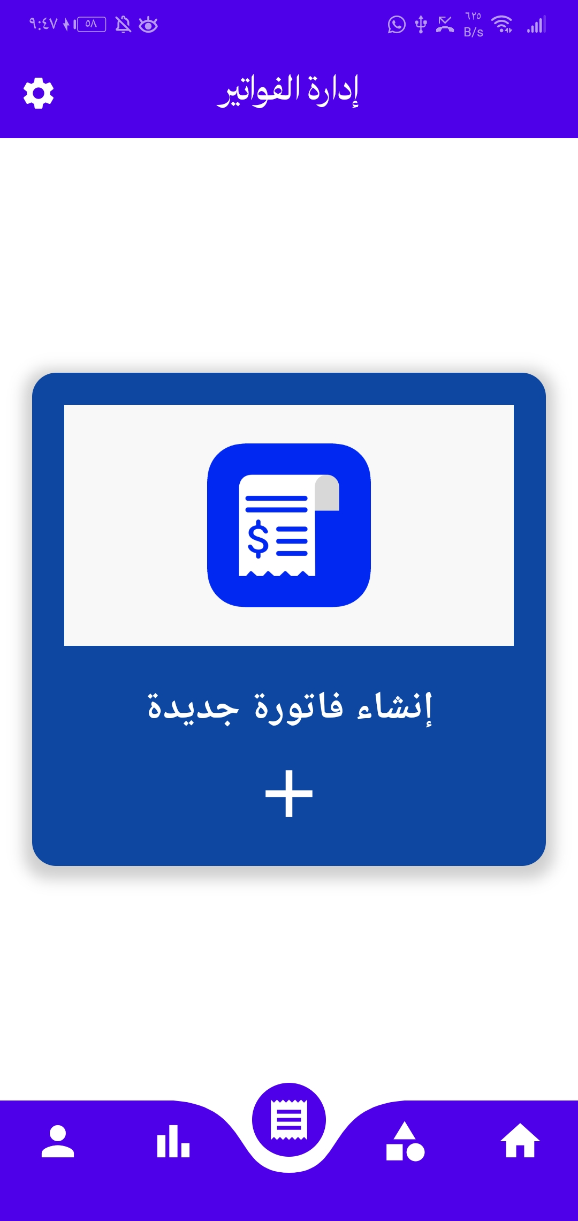
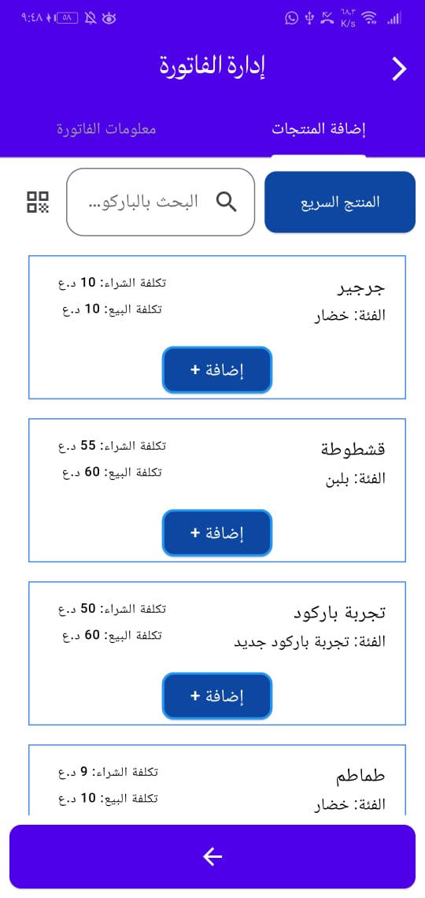
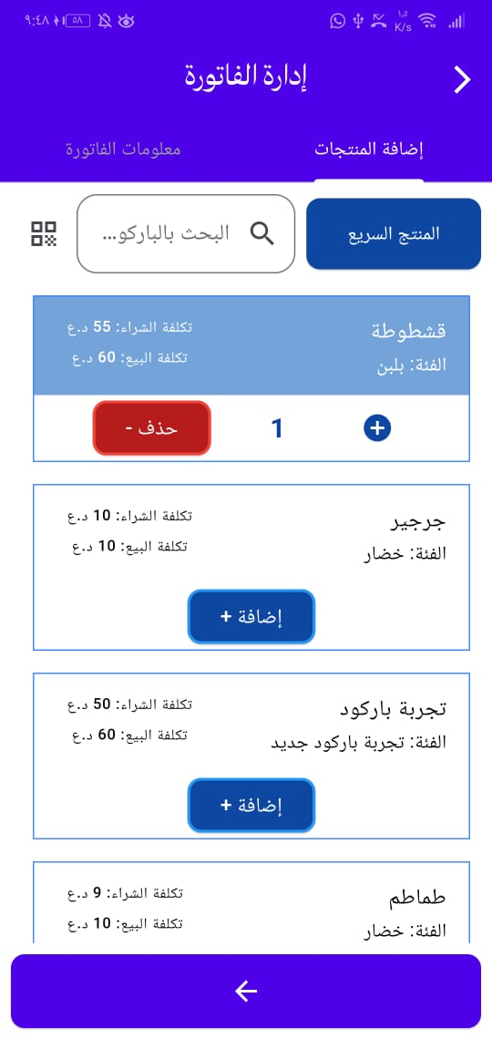
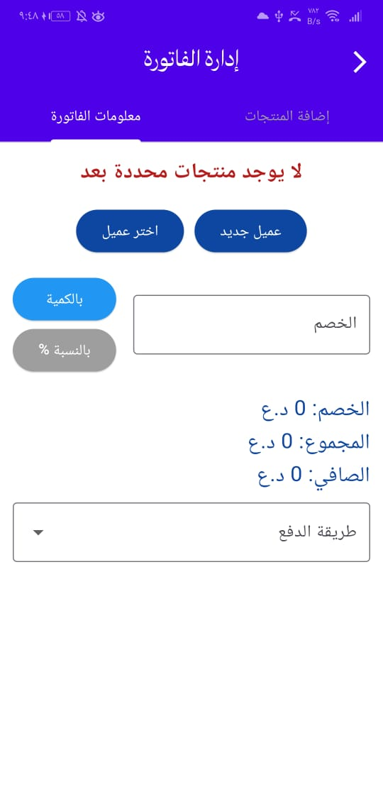
Eslam Saeed Abd Elaty

Slide 5
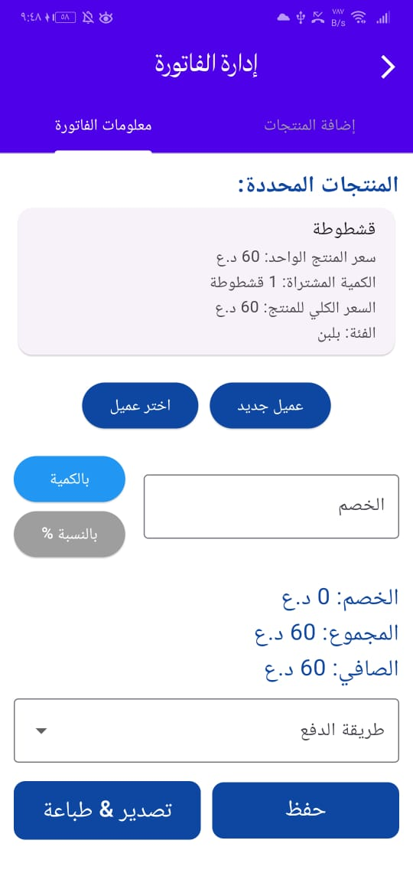
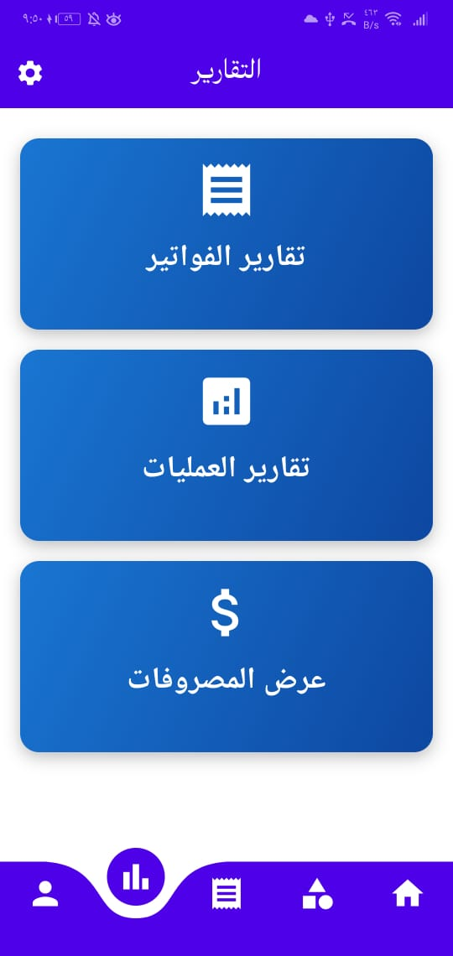
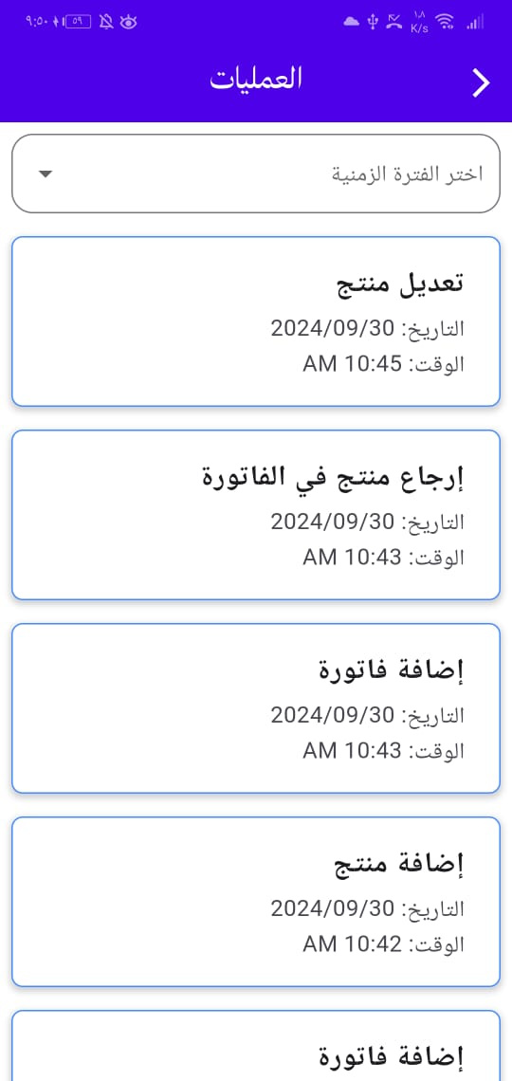
Eslam Saeed Abd Elaty

Slide 6



Hossam Hazem
Programming everything related to logic and creating data base with some ui:

Slide 7
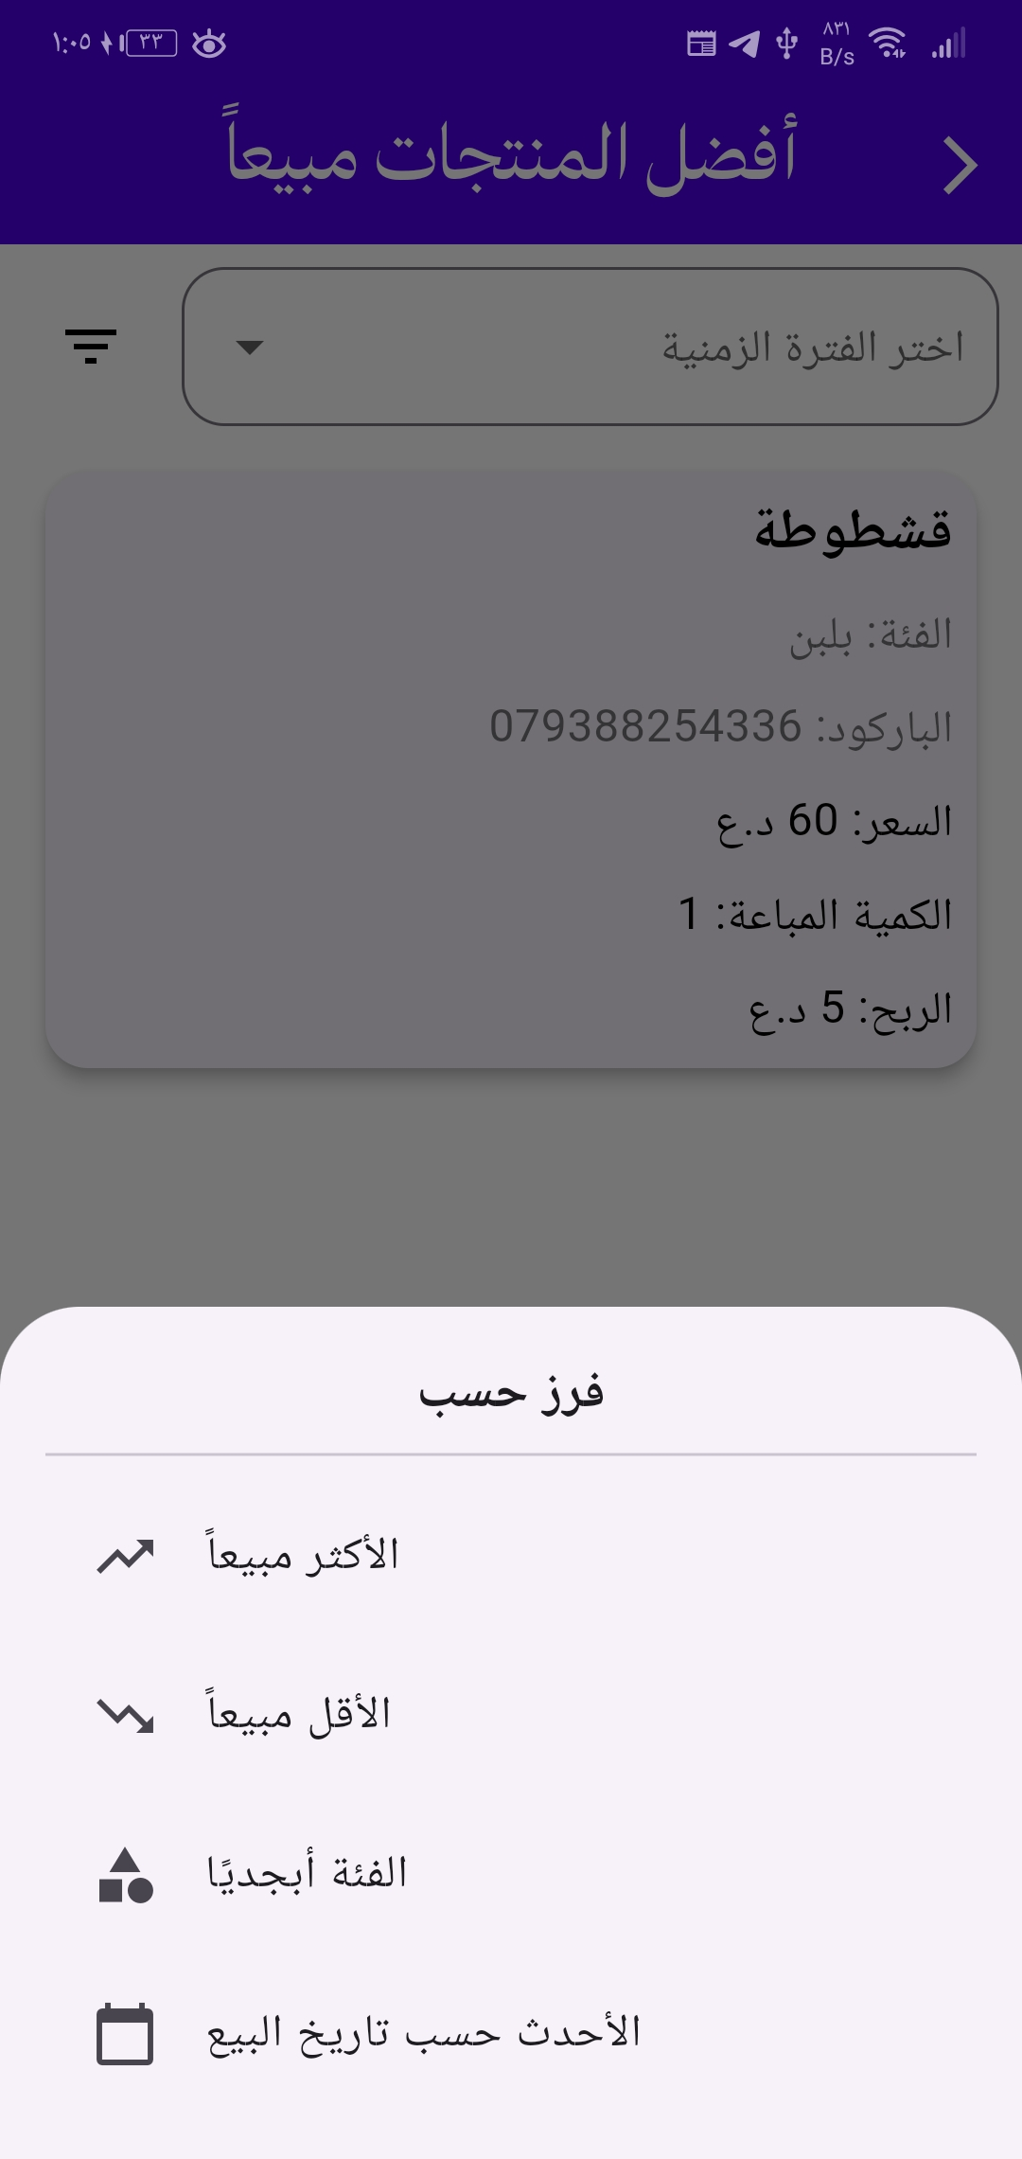


Hossam Hazem

Slide 8
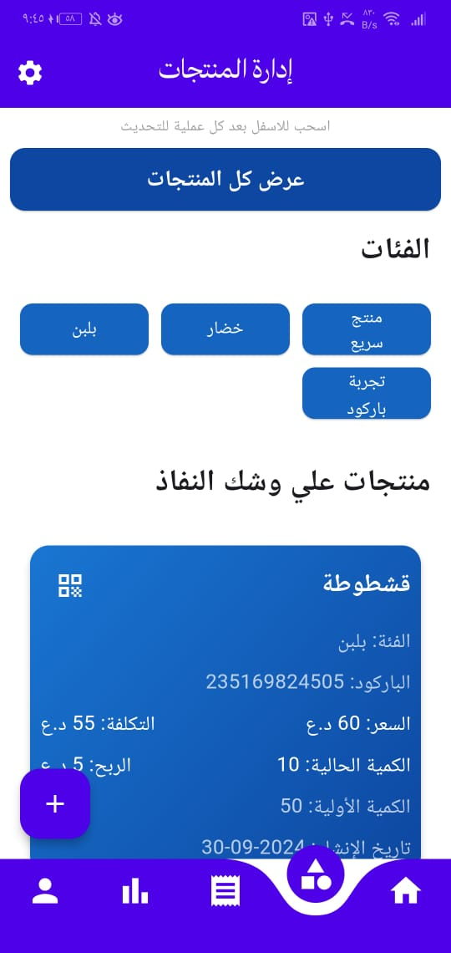
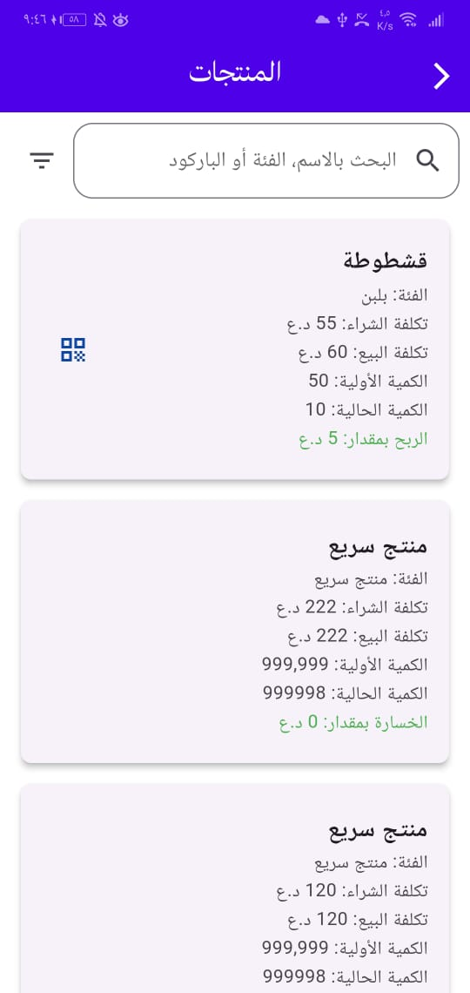
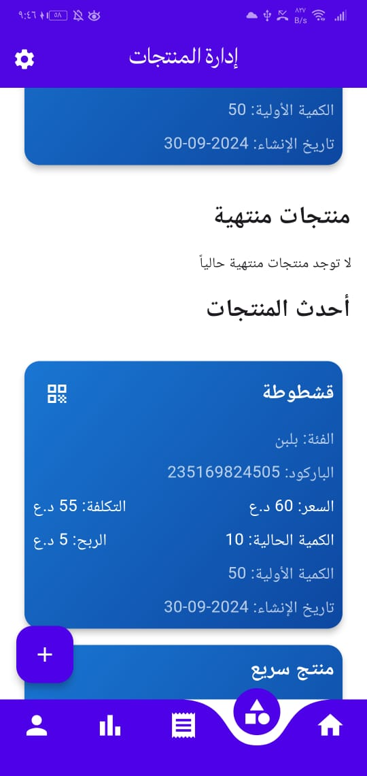
Ahmed Abd Elkareem Fawzy

Slide 9
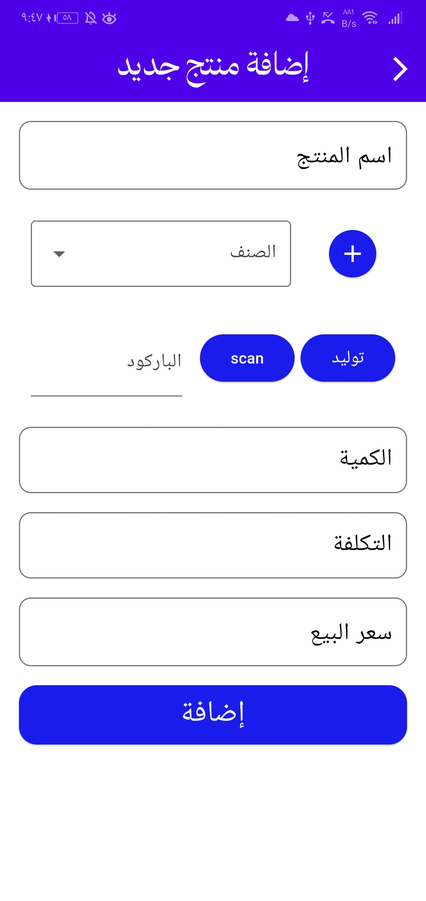
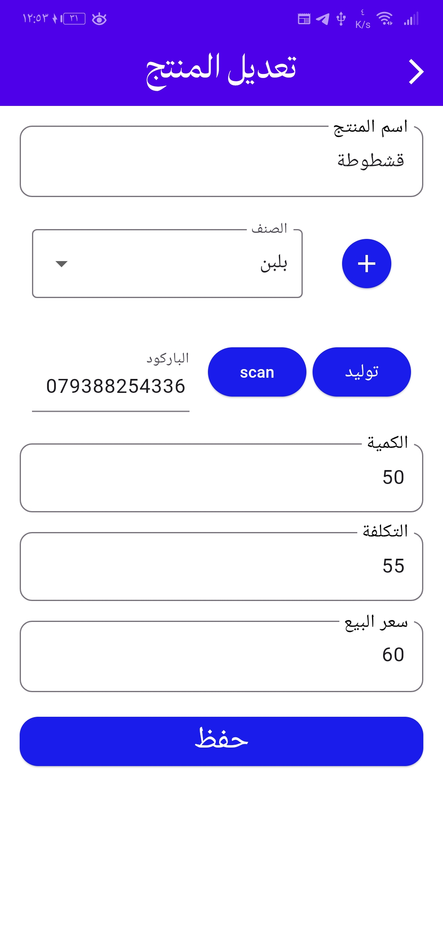
Ahmed Abd Elkareem Fawzy

Slide 10
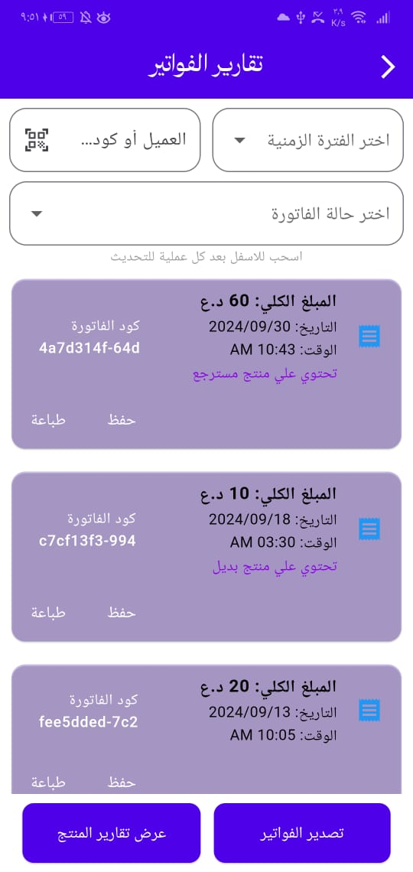
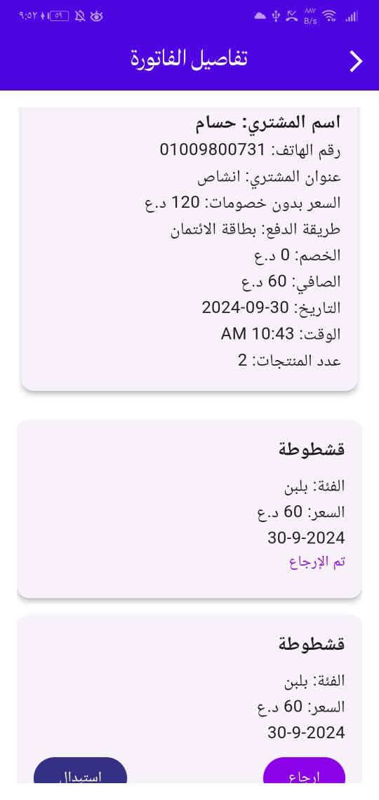
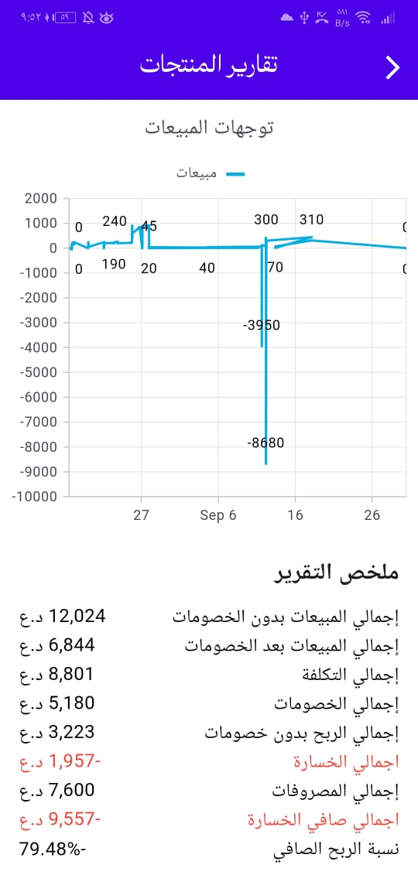
Reem Mahmoud Mohamed

Slide 11
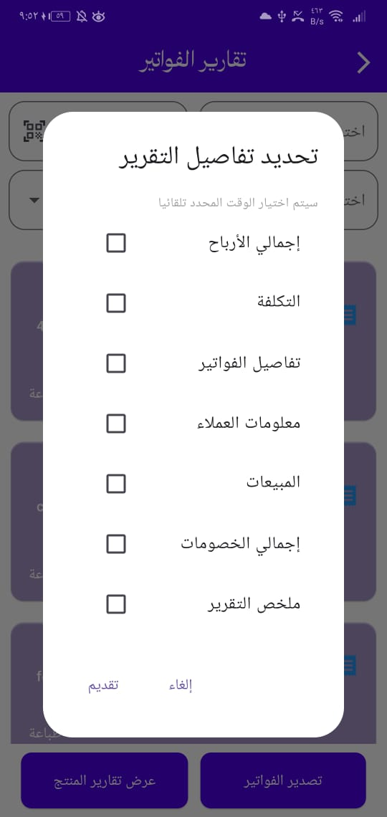

Reem Mahmoud Mohamed

Slide 12

Thanks for your time.

